Slide 1
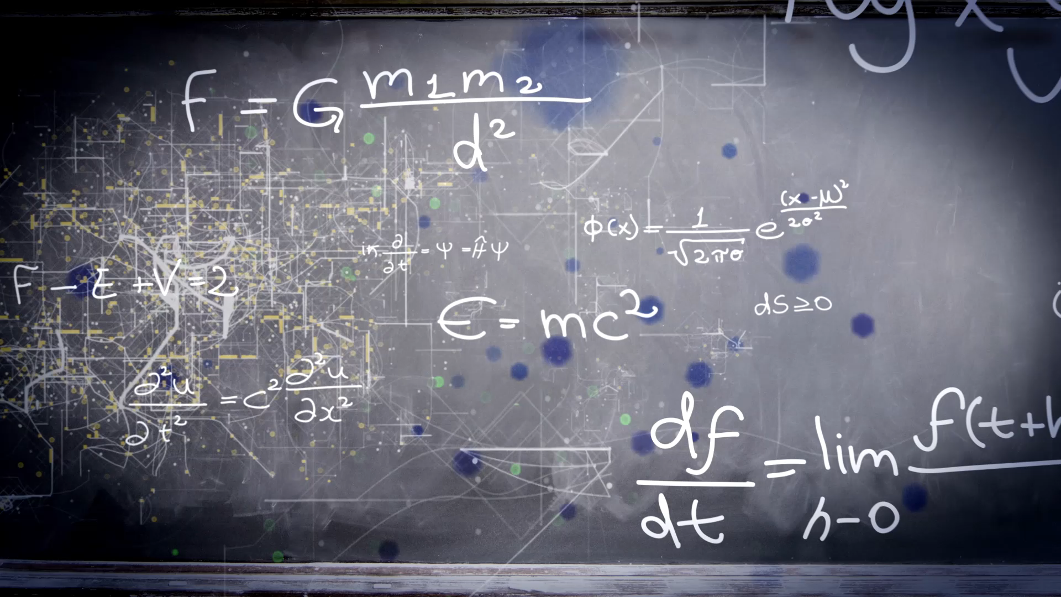
Build a system with the fewest possible instructions such that it can perform the fundamental arithmetic and logic operations.
Name: Abin Roy ID: 2020-1-60-141 | Name: Eva Islam ID: 2020-1-60-273
Name: Abdullah al Tamim ID: 2020-1-60-127 | Name: Fatema Akter ID: 2020-1-60-115

Slide 2

Project Description
The Arithmetic and Logic Unit performs simple addition, subtraction, multiplication, division, and logic operations, such as OR and AND.

Slide 3

Logic operations
AND .NOR
OR
NOT
XOR
XNOR
NAND

Slide 4

Arithmetic Operations
Developed an arithmetic simplifier.
The functions are addition, subtraction, multiplication ,division, square, trigonometry, simplification, MOD, logarithm, square root and percentage
Infix to the Postfix converter and vice versa
Ascending and descending sort using Quick Sort Algorithm

Slide 5

Thank you

